Slide 1
Microsoft Power BI

Slide 2
Power BI Dev Camp – Session 3 Deep Dive into the Power BI JavaScript API
Ted Pattison
Principal Program Manager
Customer Advisory Team (CAT) at Microsoft

Slide 3
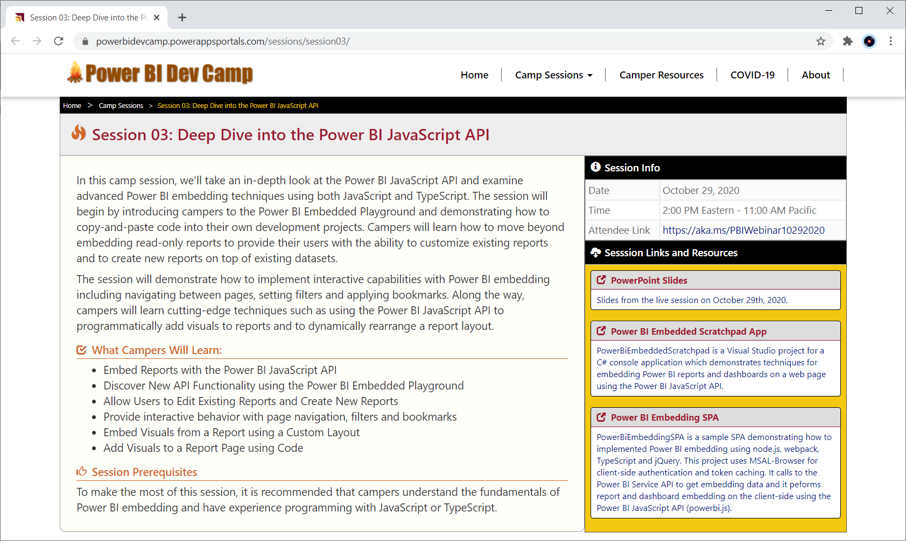
Welcome to Power BI Dev Camp
Power BI Dev Camp Portal - https://powerbidevcamp.net

Slide 4
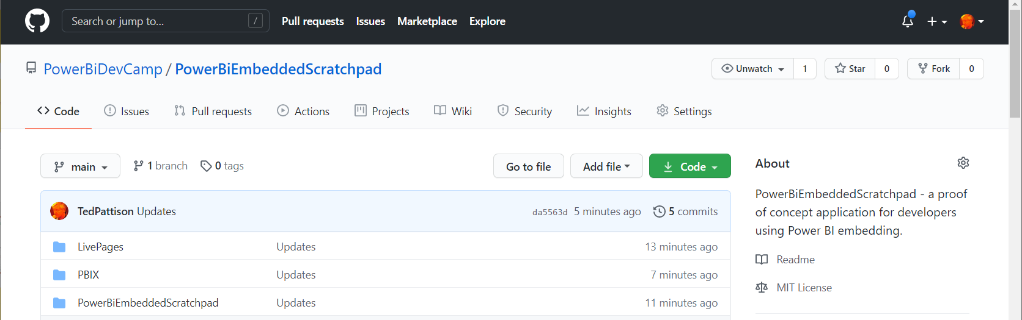
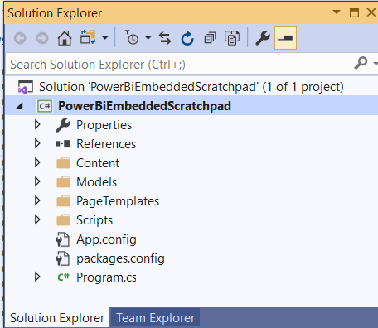
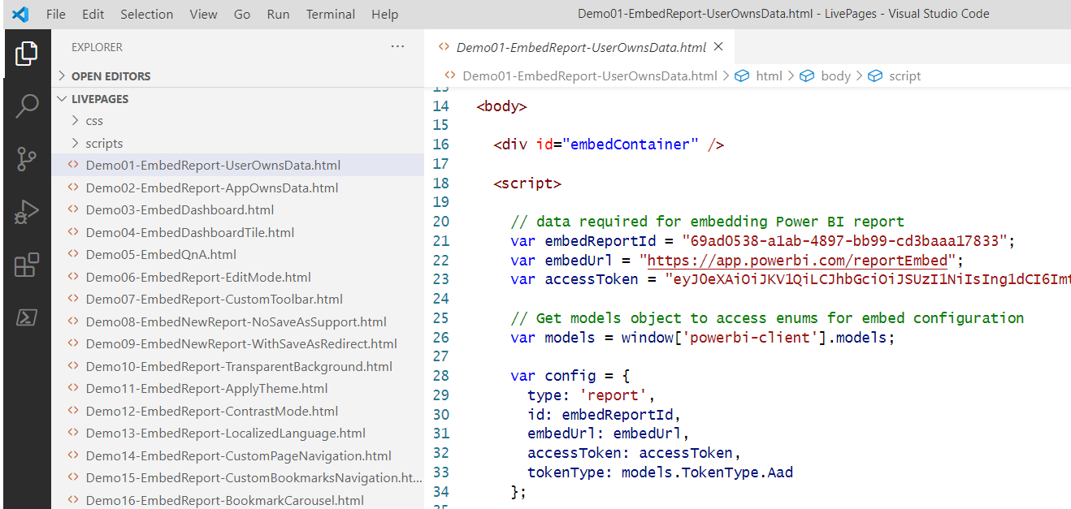
PowerBiEmbeddedScratchpad Sample Application
https://github.com/PowerBiDevCamp/PowerBiEmbeddedScratchpad
Running App Create Test Pages

Slide 5
Agenda
Power BI Embedding 101
Building Interactive Experiences
Programming with Report Events
Customizing Report Layouts
Advanced Embedding Topics
SPA Architecture with MSAL.JS

Slide 6
Power BI Embedding – The Big Picture
User launches your app using a browser
App authenticates with Azure Active Directory and obtains access token
App uses access token to call to Power BI Service API
App retrieves data for embedded resource and passes it to browser.
Client-side code uses Power BI JavaScript API to create embedded resource
Embedded resource session created between browser and Power BI service
5
Power BI Service
Browser
iFrame
6
4
4
3
1
Your App
2
Azure AD

Slide 7
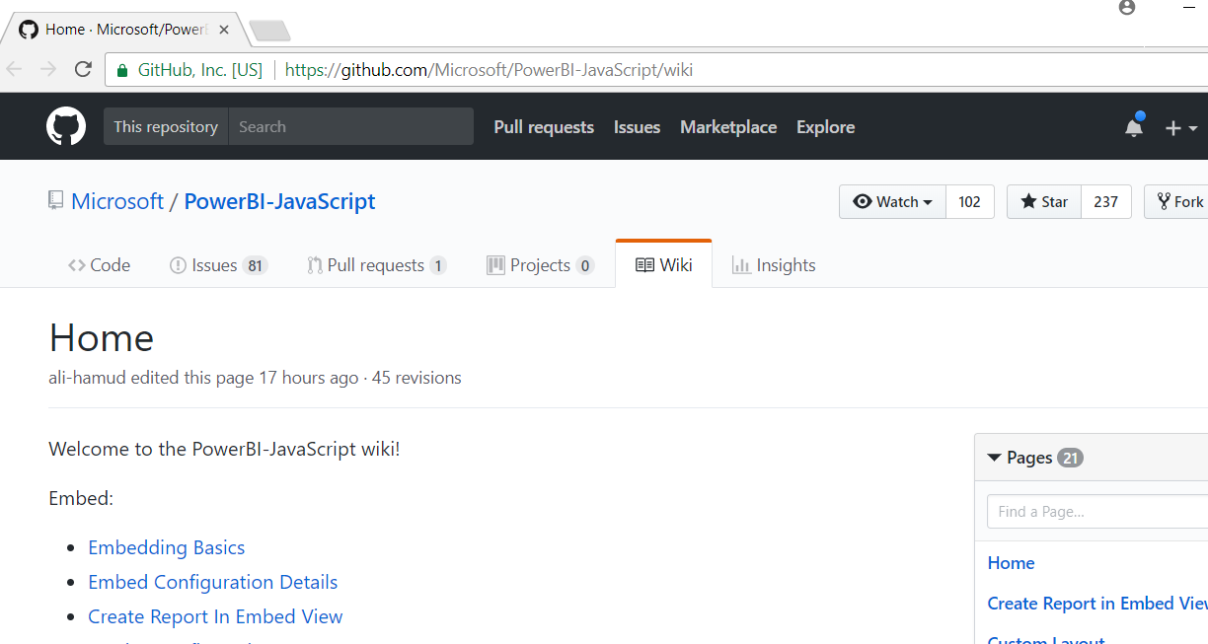
Power BI JavaScript API (powerbi.js)
Power BI JavaScript API used to embed resources in browser
GitHub repo at https://github.com/Microsoft/PowerBI-JavaScript/wiki
GitHub repository contains code, docs, wiki and issues list

Slide 8
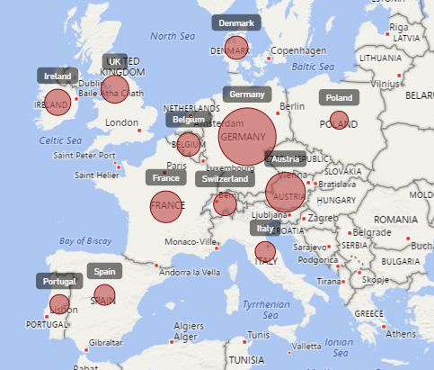
Report Embedding Architecture
Embedding involves creating an iFrame on the page
PBIJS transparently creates iFrame and sets source to Power BI Service
The iFrame and hosting page originate from different DNS domains
https://app1.mydomain.com
Your HTML and CSS
Web Hosting Server
Your
JavaScript
iFrame
Embedding Data
https://wabi-us-east2-redirect.analysis.windows.net/
powerbi.js
Power BI Service

Slide 9
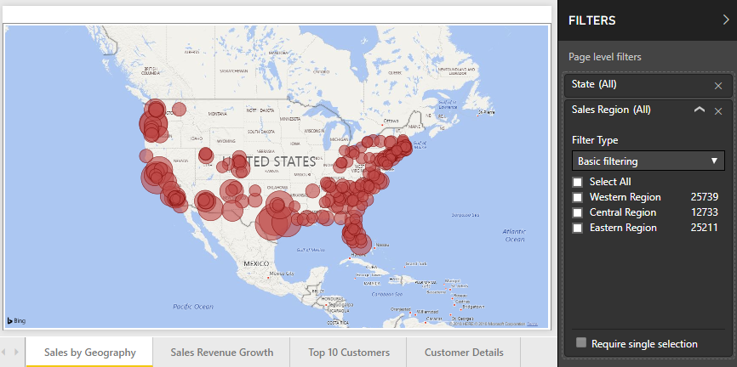
A Promise-based Programming Model
Design of PBIJS simulates HTTP protocol
Creates more intuitive programming model for developers
Programming based on asynchronous requests and promises
Embedded objects programmed using actions and events
Actions
report.fullscreen
report
report.switchMode
report.setFilters
Your
JavaScript
report.getPages
Events
report.loaded
report.pageChanged
report.commandTriggered

Slide 10
User-Owns-Data Embedding vs App-Owns-Data Embedding
User-Owns-Data Embedding
All users require a Power BI license
Useful in corporate environments
App authenticates as current user
Your code runs with user’s permissions
User’s access token passed to browser
App-Owns-Data Embedding
No consumers require Power BI license
Useful for commercial applications
App authenticates with app-only identity
Your code runs with admin permissions
Embed token passed to browser
User-Owns-Data Embedding for use within Organization
App-Owns-Data Embedding for use by ISVs
Browser
Power BI Service
Browser
Power BI Service
iFrame
Azure AD
Access Token
for the current user
iFrame
Power BI
Embed Token
for specific report

Slide 11
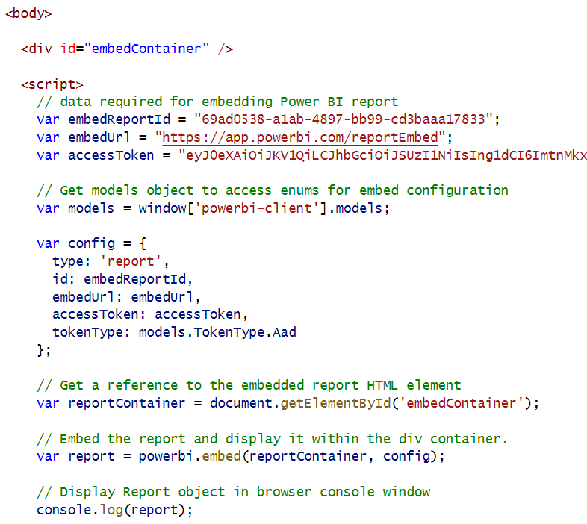
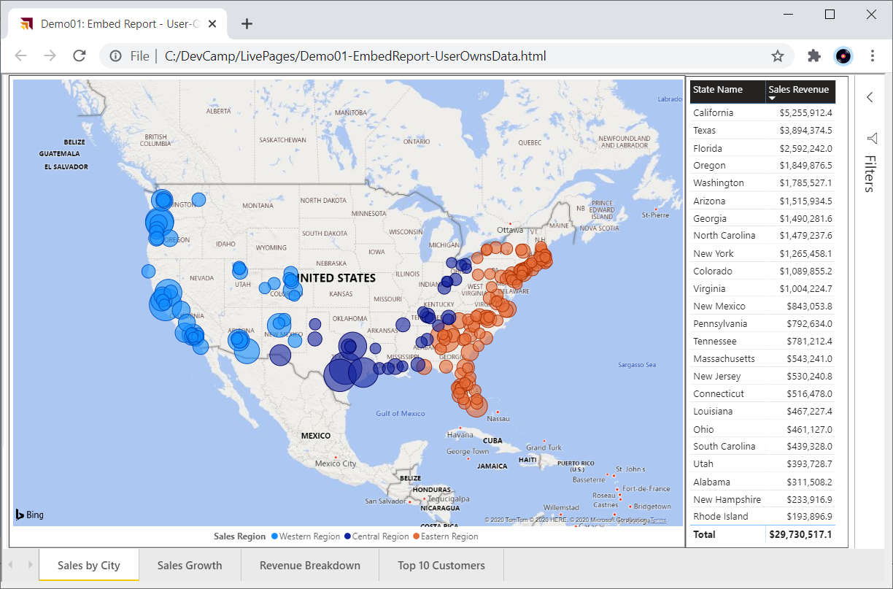
User-Owns-Data Embedding

Slide 12
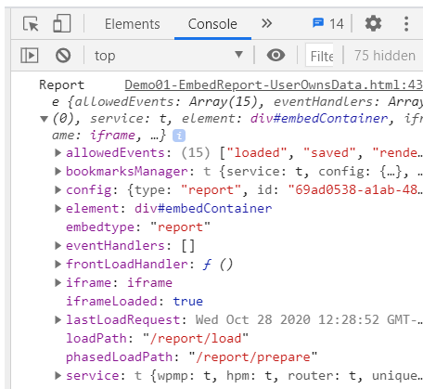
Viewing Report Object in Chrome Dev Tools

Slide 13
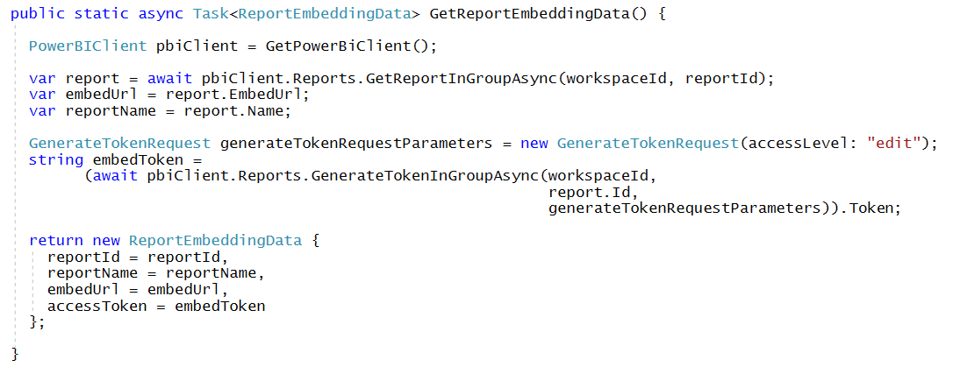
Getting the Data for App-Owns-Data Report Embedding

Slide 14
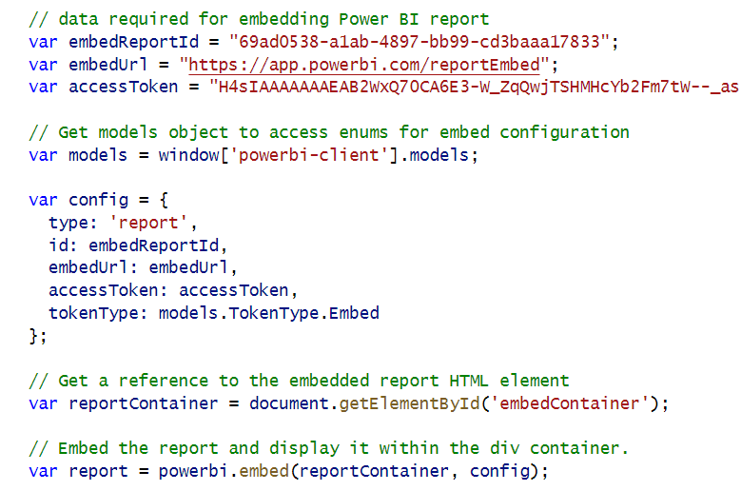
App-Owns-Data Embedding

Slide 15
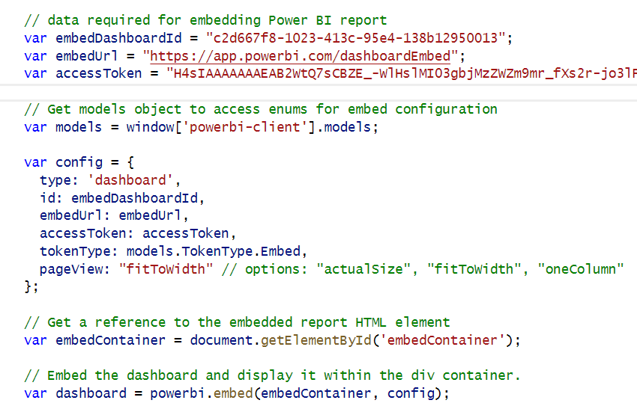
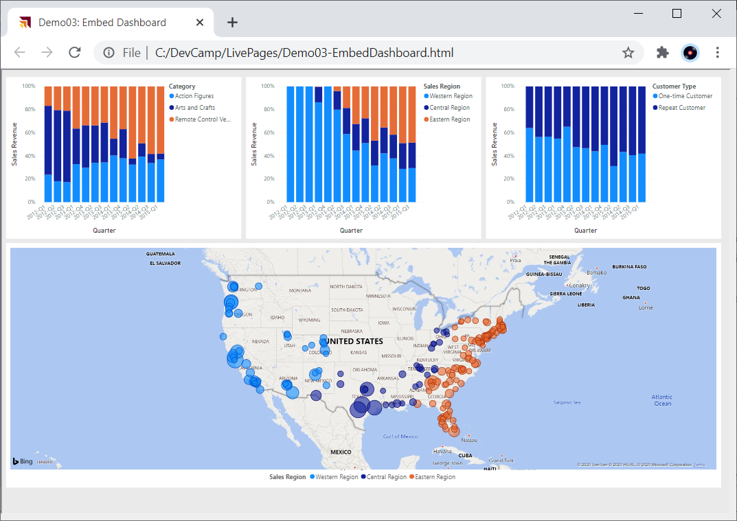
Embedding a Dashboard

Slide 16
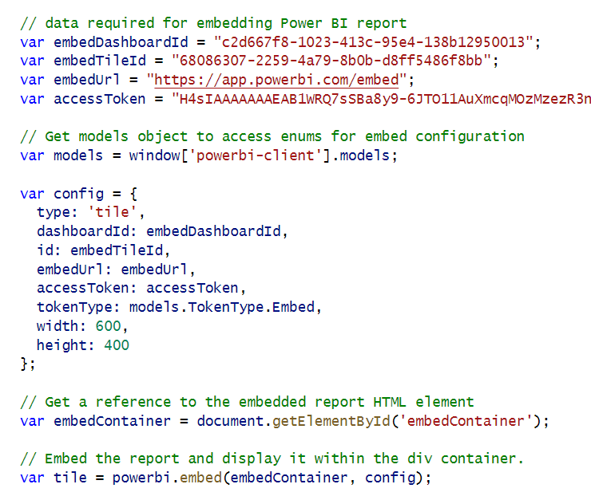
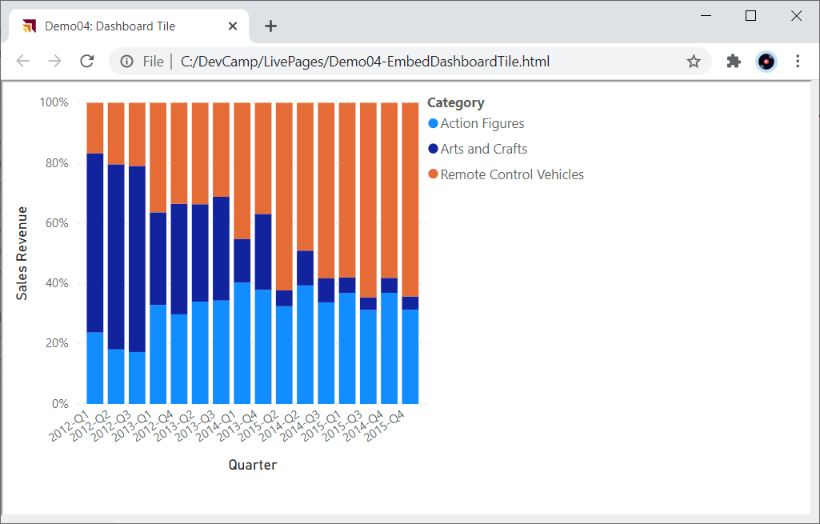
Embedding a Dashboard Tile

Slide 17
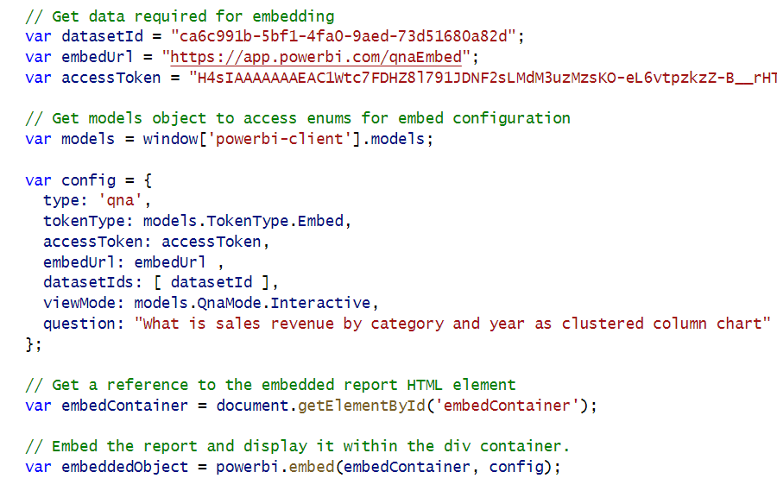
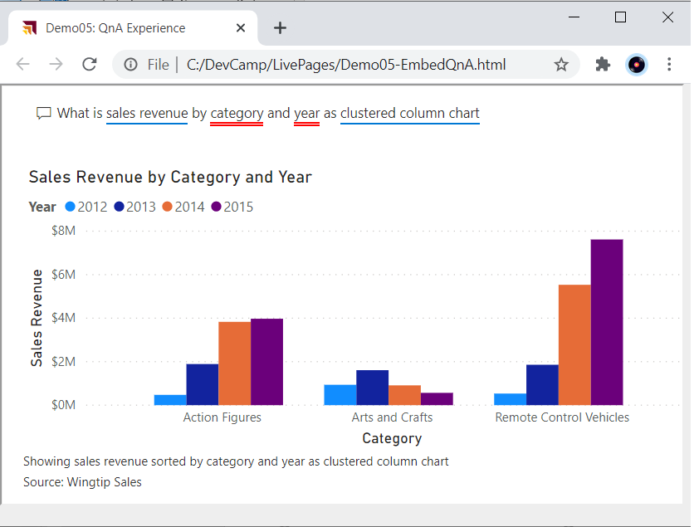
Embedding the QnA Experience

Slide 18
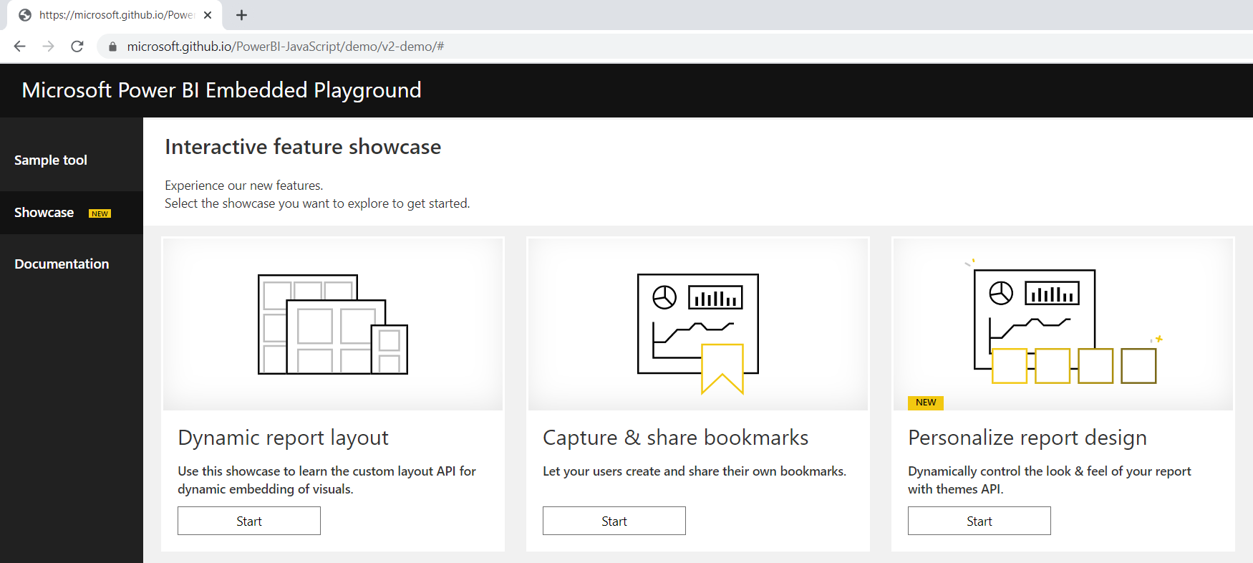
Power BI Embedded Playground
https://microsoft.github.io/PowerBI-JavaScript/demo/v2-demo/#

Slide 19
Agenda
Power BI Embedding 101
Building Interactive Experiences
Programming with Report Events
Customizing Report Layouts
Advanced Embedding Topics
SPA Architecture with MSAL.JS

Slide 20
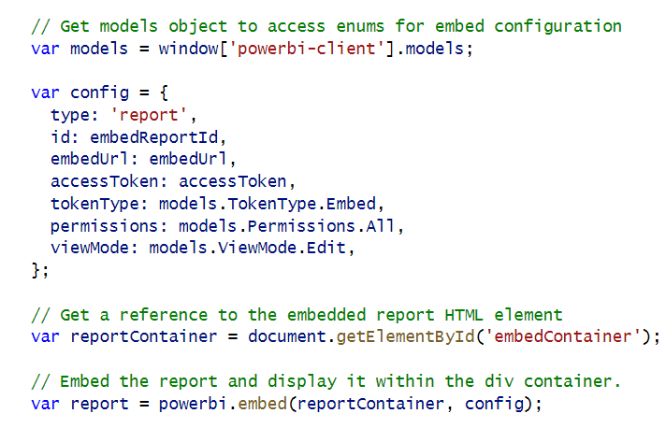
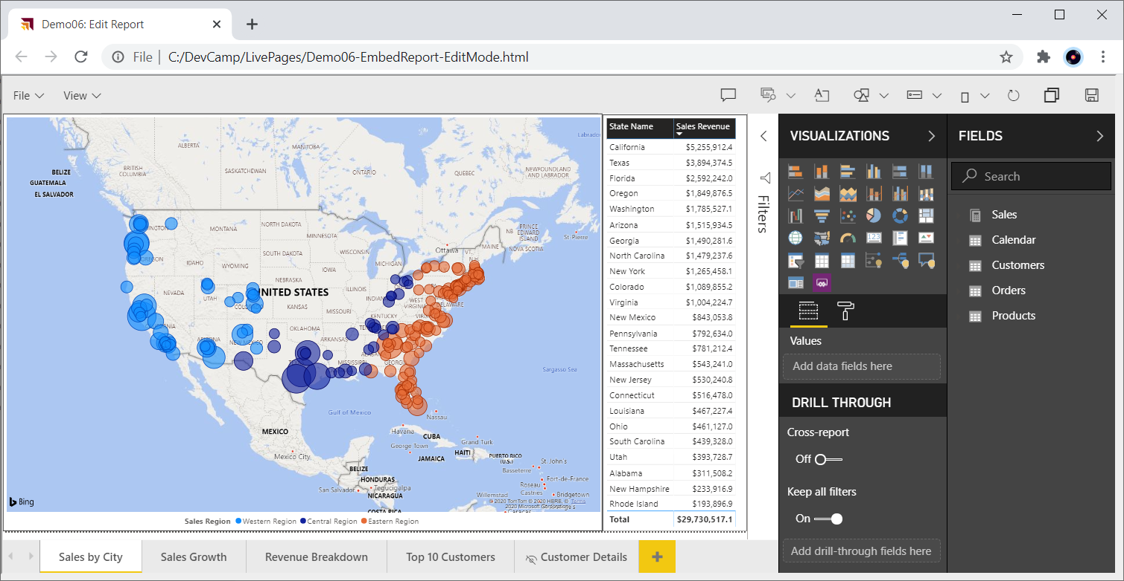
Embedding Reports in Edit Mode

Slide 21
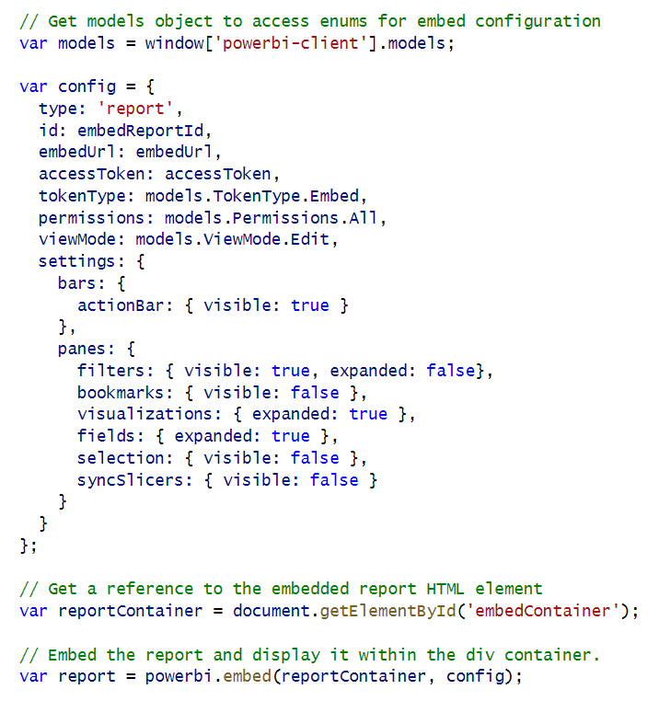
Report Panes

Slide 22
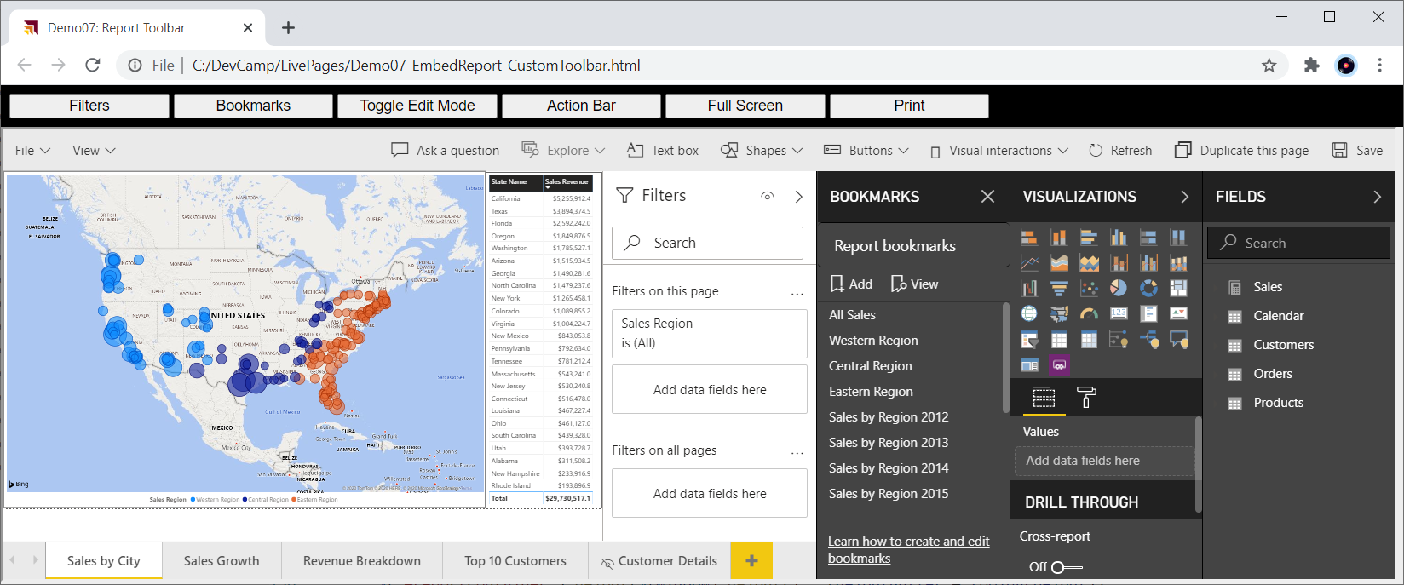
Embedding with a Custom Toolbar

Slide 23
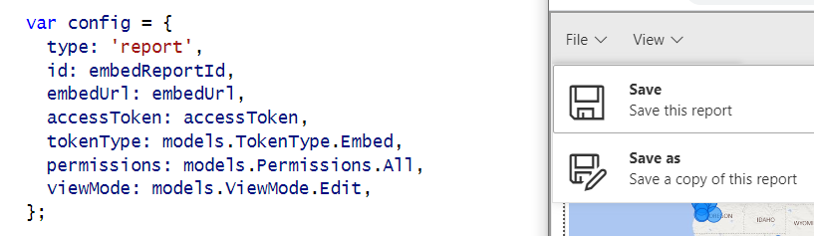
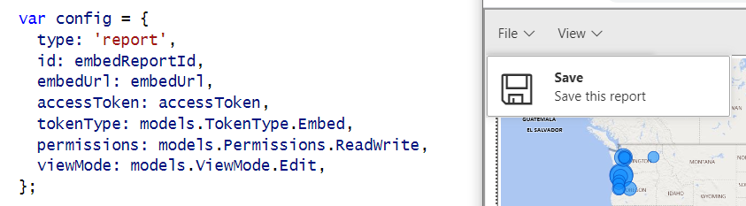
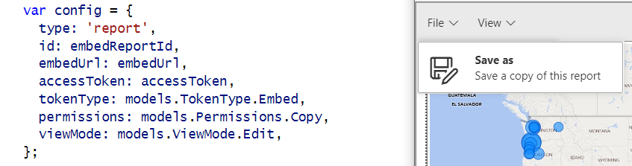
Showing and Hiding the Save and Save as Menus
permissions: models.Permissions.All
permissions: models.Permissions.ReadWrite
permissions: models.Permissions.Copy

Slide 24
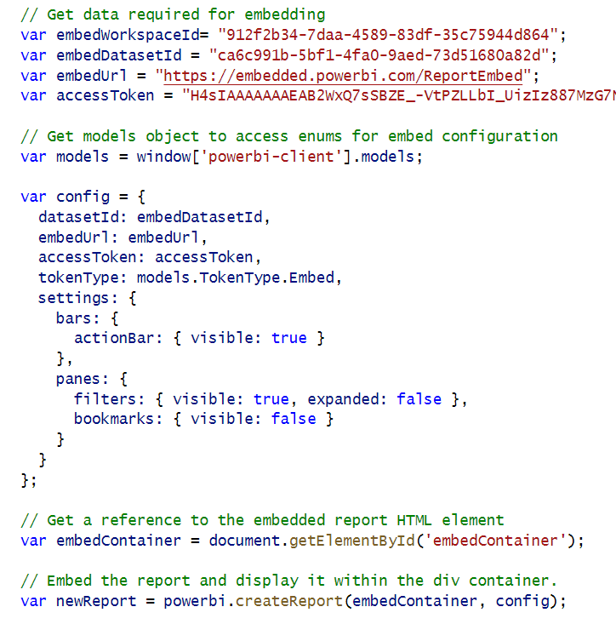
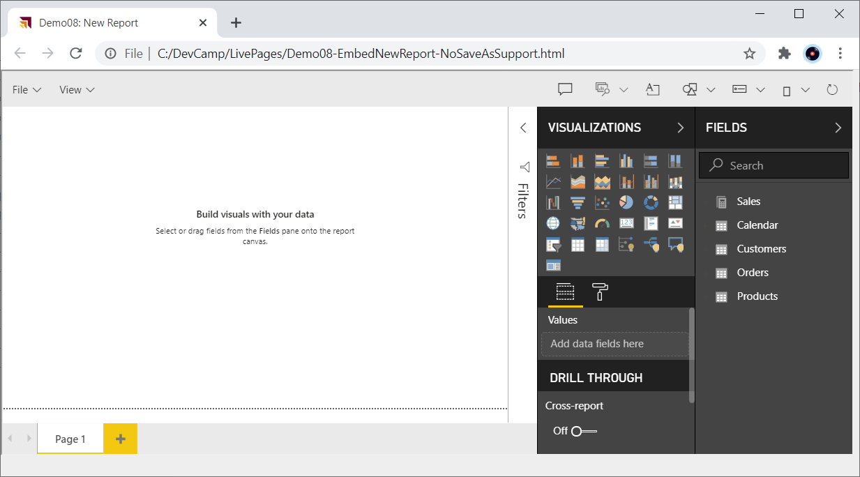
Embed a New Report

Slide 25
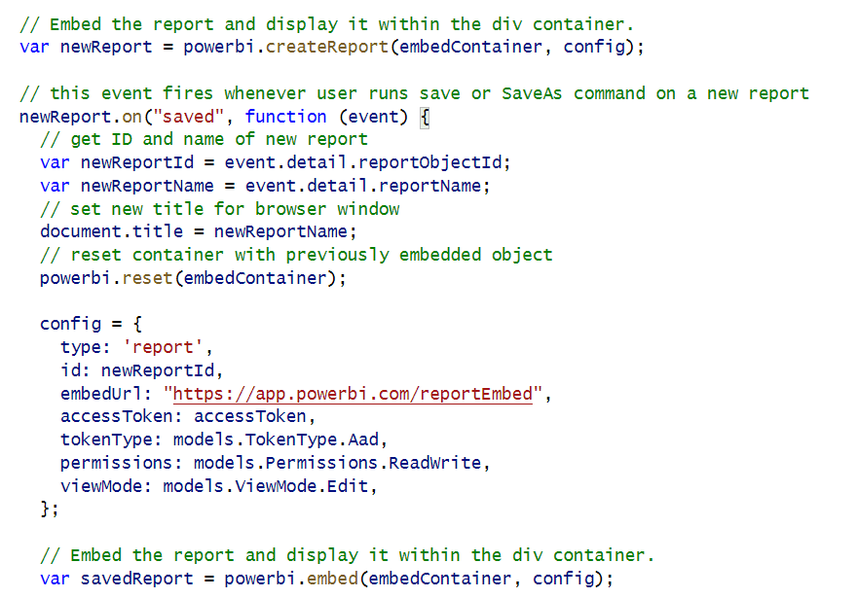
New Report with Save As Redirect

Slide 26
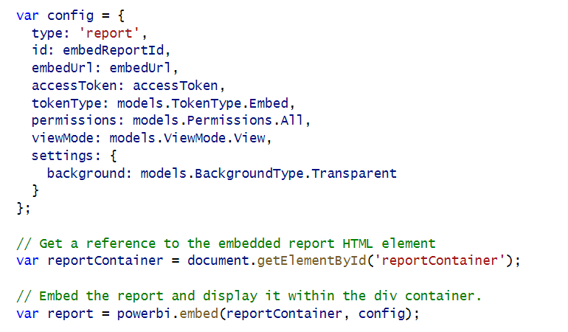
Embed Report with Transparent Background

Slide 27
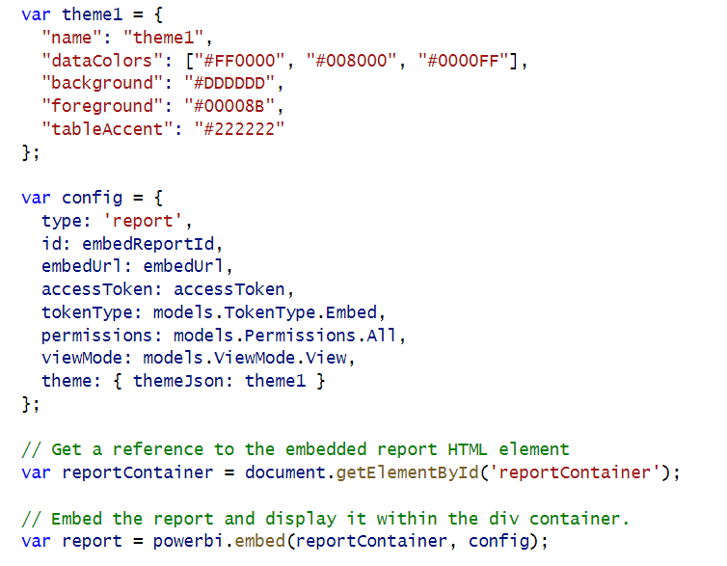
Applying Report Themes

Slide 28
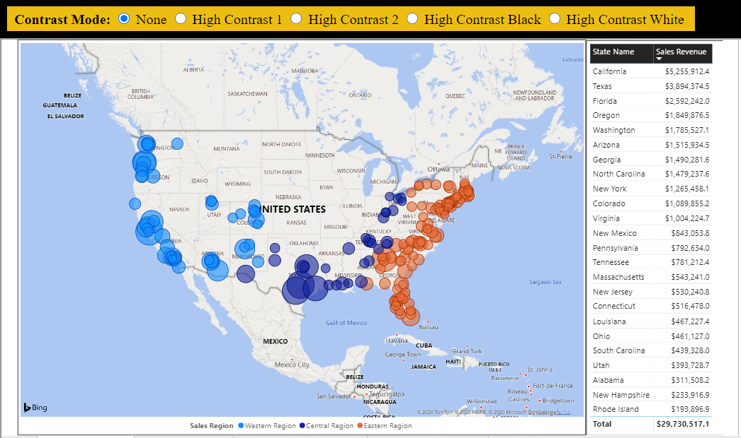
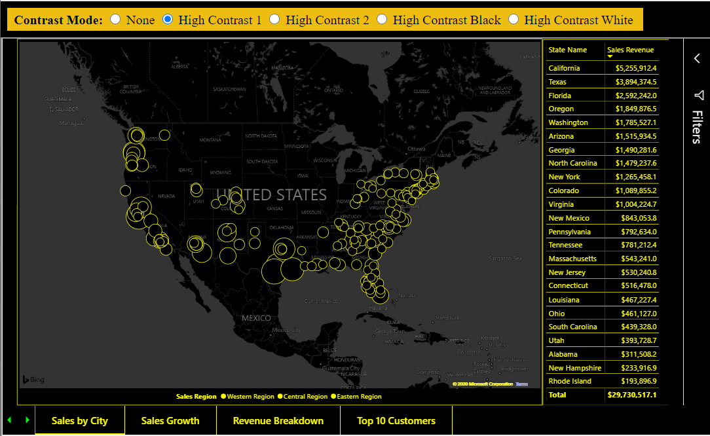
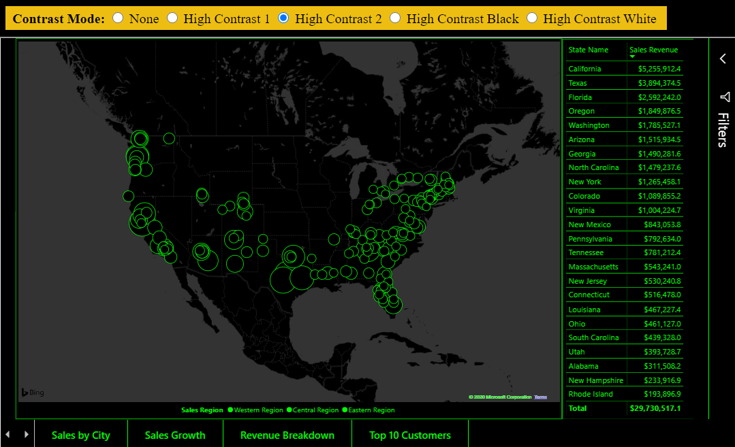
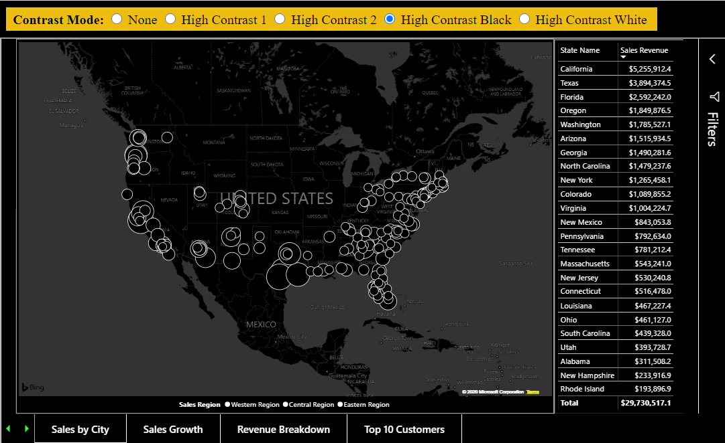
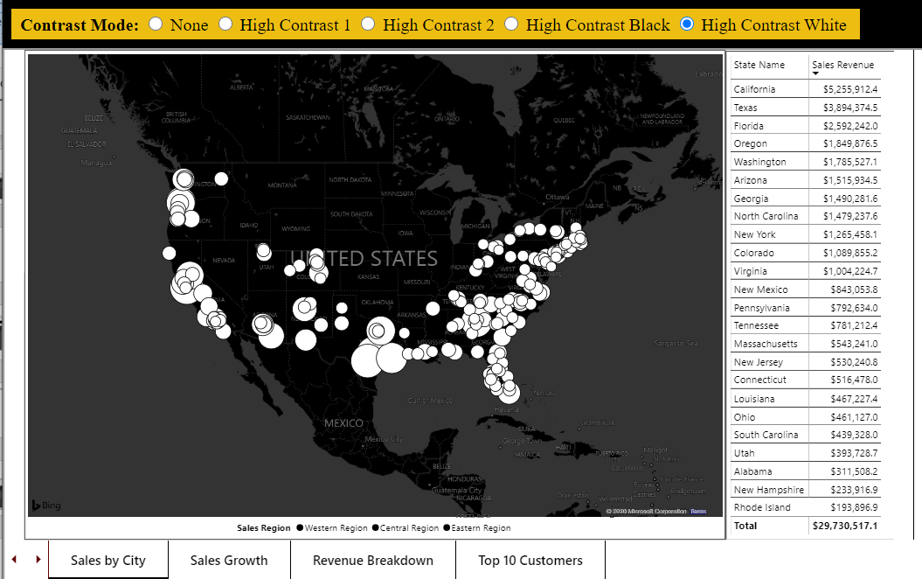
Contrast Mode

Slide 29
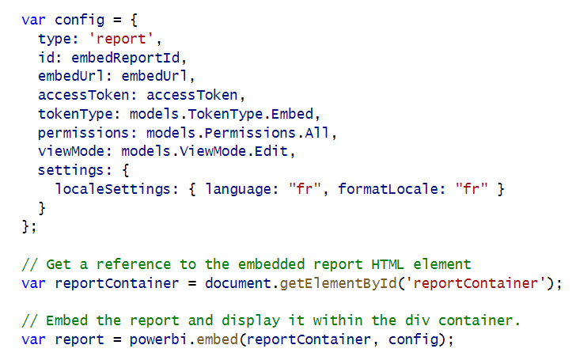
Loading Reports with Localized Languages

Slide 30
Agenda
Power BI Embedding 101
Building Interactive Experiences
Programming with Report Events
Customizing Report Layouts
Advanced Embedding Topics
SPA Architecture with MSAL.JS

Slide 31
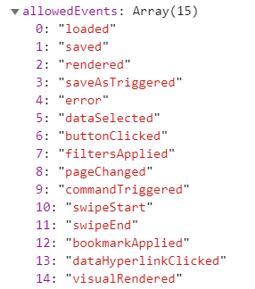
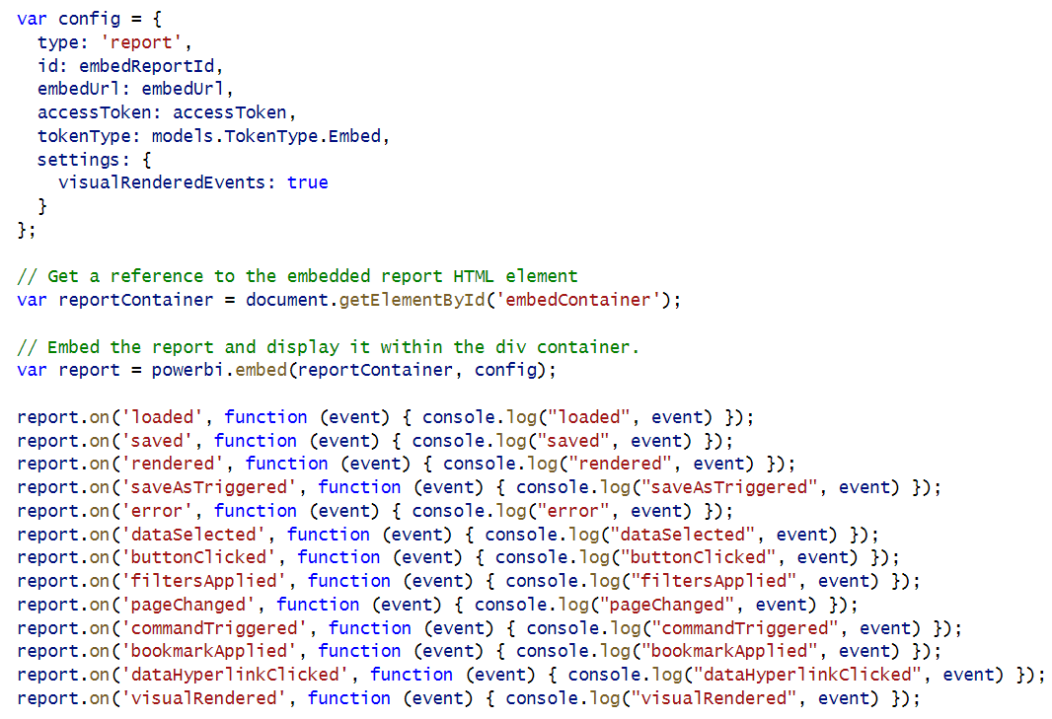
Report Allowed Events

Slide 32
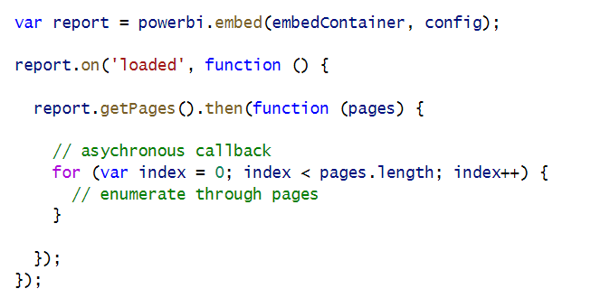
Calling report.getPages() in the loaded event

Slide 33
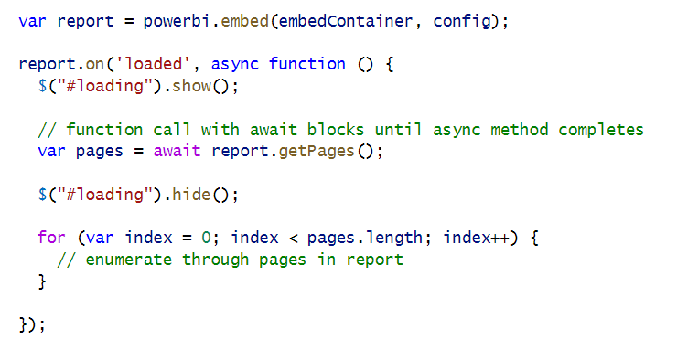
Using async and await keywords in JavaScript

Slide 34
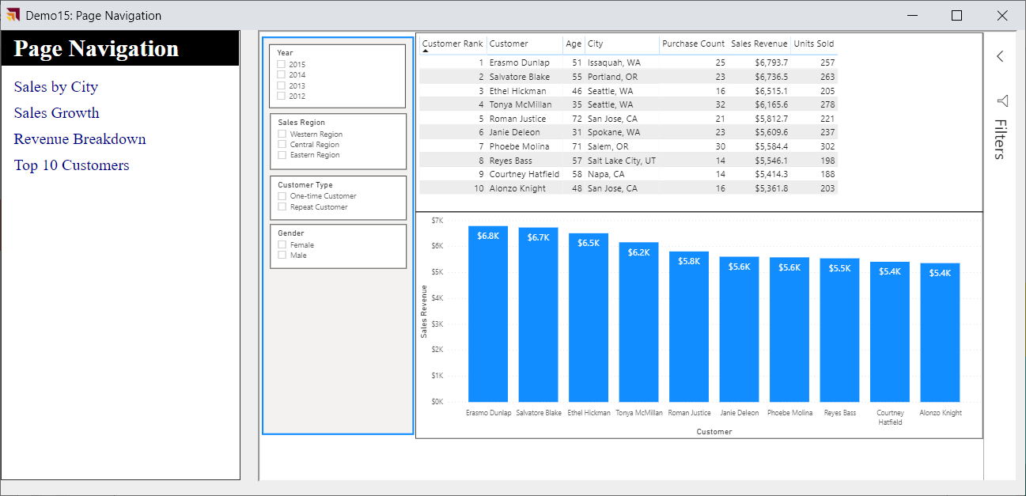
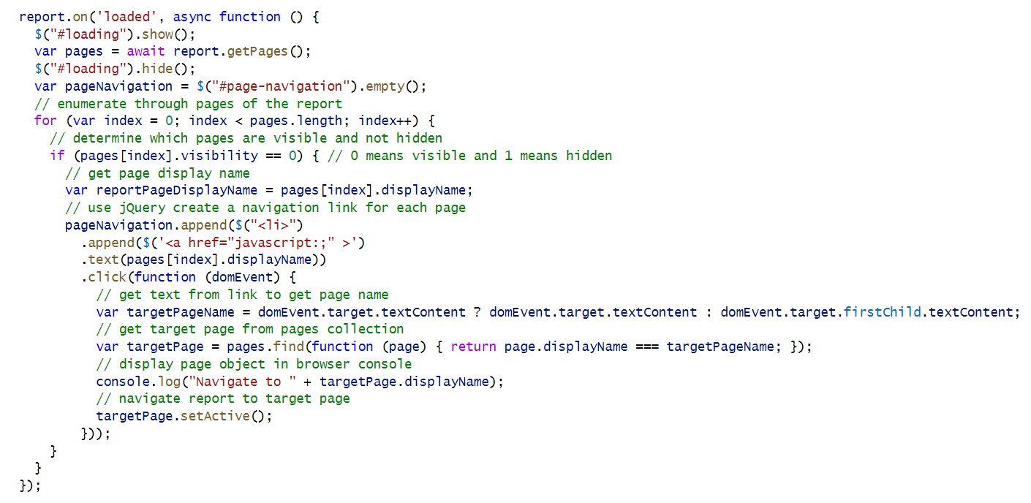
Custom Page Navigation

Slide 35
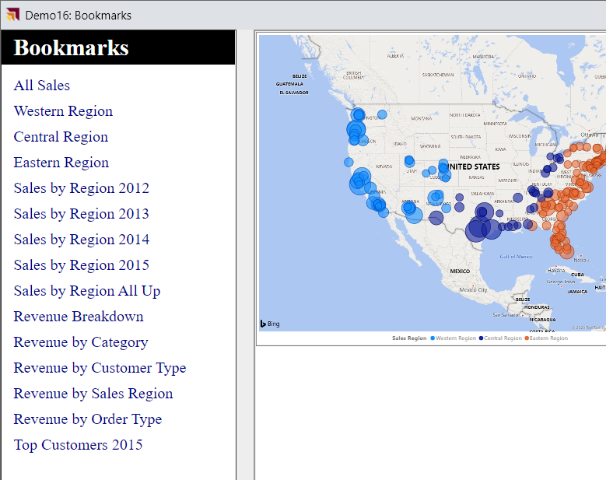
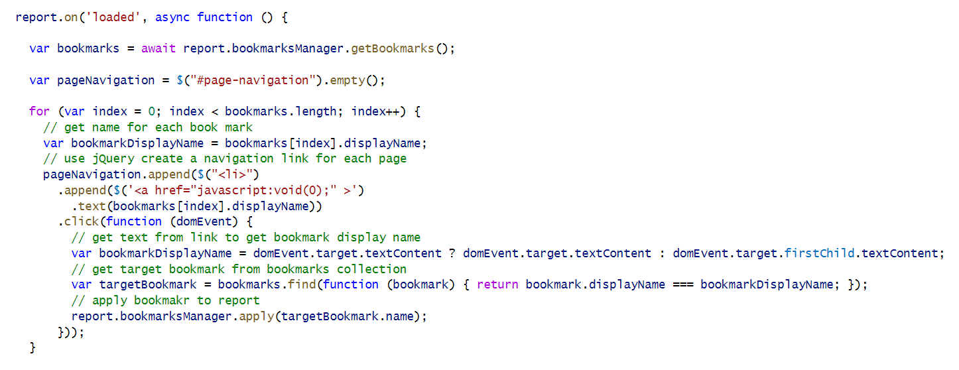
Custom Bookmark Navigation

Slide 36
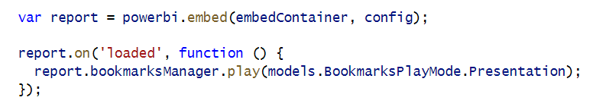
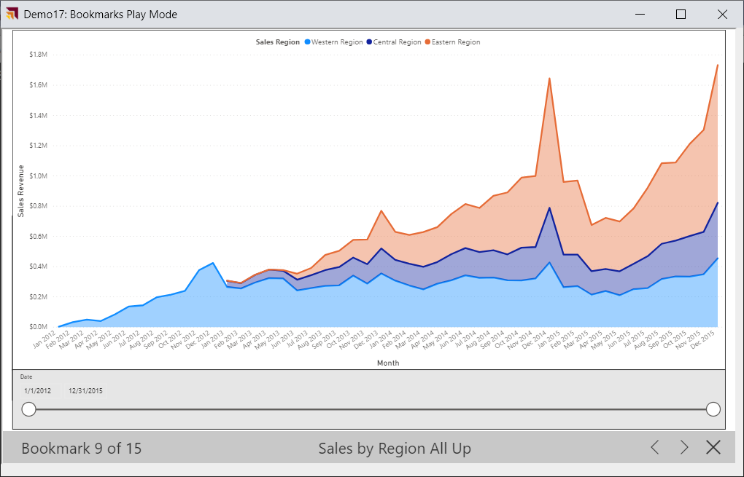
Bookmark Play Mode

Slide 37
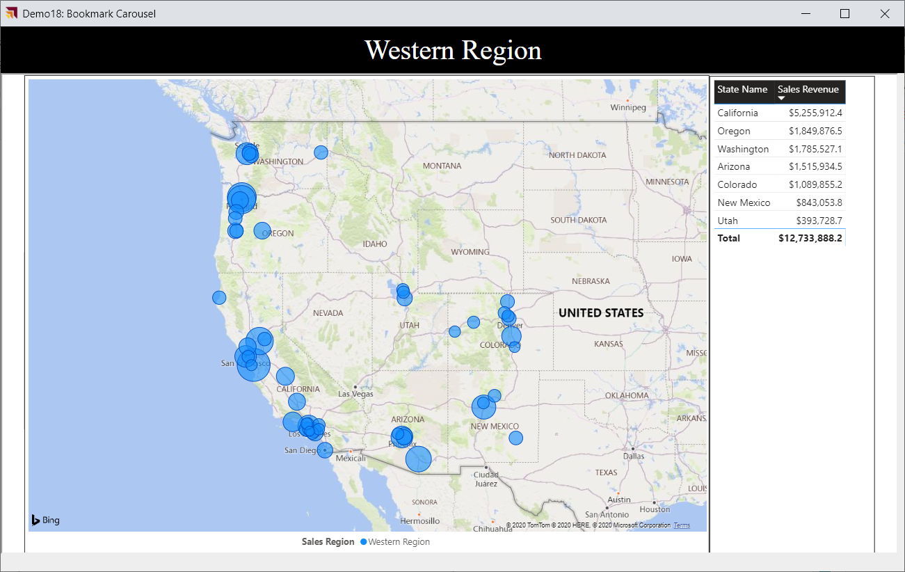
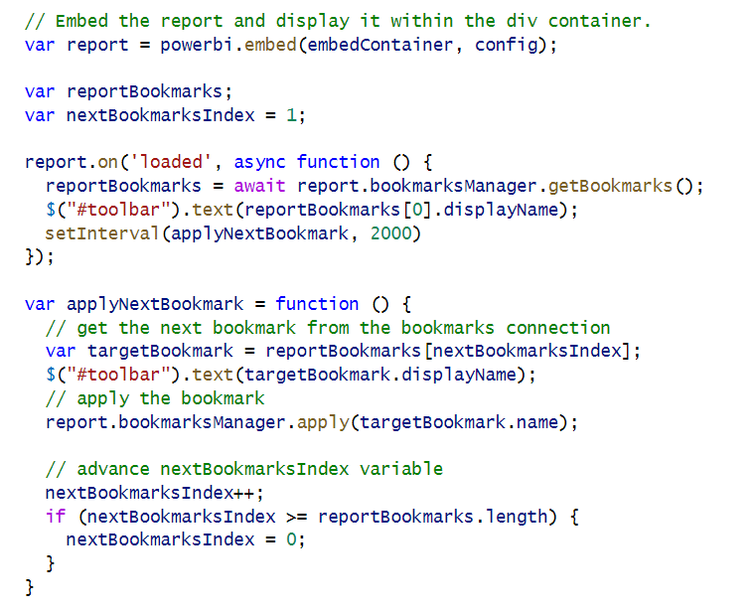
Bookmark Carousel

Slide 38
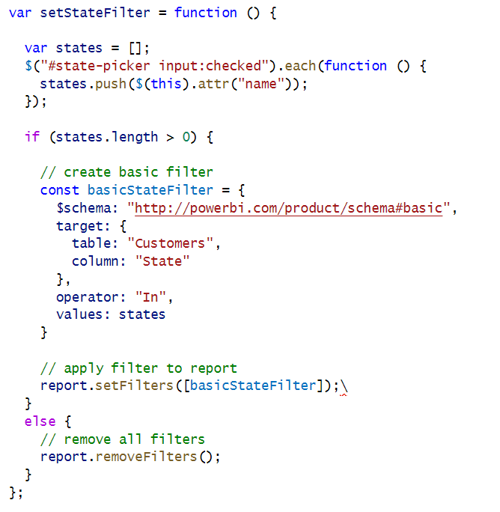

Implementing a Custom Filtering Experience

Slide 39

Phased Embedding

Slide 40


White Label Report Loading

Slide 41

Bootstrap Optimization in Report Loading

Slide 42


Adding Visual Menu Commands

Slide 43

Hiding Built-in Visual Menu Commands

Slide 44


Create a Custom Visual Export Command

Slide 45
Agenda
Power BI Embedding 101
Building Interactive Experiences
Programming with Report Events
Customizing Report Layouts
Advanced Embedding Topics
SPA Architecture with MSAL.JS

Slide 46


Determining Visual Names with Visual Inspector

Slide 47

Embedding a Single Visual
Limit this to one visual embed per page – it really embeds the whole report then shows one visual

Slide 48

Custom Report Page Layouts

Slide 49
Agenda
Power BI Embedding 101
Building Interactive Experiences
Programming with Report Events
Customizing Report Layouts
Advanced Embedding Topics
SPA Architecture with MSAL.JS

Slide 50


Generating Embed Tokens with EffectiveIdentity

Slide 51

Auditing App-Owns-Data User with Correlation ID
Problem: apps-owns-data does add username to PBI audit logs
Solution: develop custom logging scheme with correlation ID

Slide 52


Dynamic Dataset Binding

Slide 53

Authoring Pages and Visuals using Code
https://github.com/microsoft/powerbi-report-authoring/wiki

Slide 54
Agenda
Power BI Embedding 101
Building Interactive Experiences
Programming with Report Events
Customizing Report Layouts
Advanced Embedding Topics
SPA Architecture with MSAL.JS

Slide 55

Sample Application - PowerBiEmbeddingSPA
https://github.com/PowerBiDevCamp/PowerBiEmbeddingSPA

Slide 56

Demo Time

Slide 57
Summary
Power BI Embedding 101
Building Interactive Experiences
Programming with Report Events
Customizing Report Layouts
Advanced Embedding Topics
SPA Architecture with MSAL.JS

Slide 58

Get Ready for Next Month

Slide 59
Questions

